Slide 1




EagleSat II- Attitude Determination and Control System (ADCS)
Grayson A Peeler- Aerospace Engineering
Mentor: Ahmed I Sulyman- Embry Riddle Aeronautical University
Hilton Tucson East- April 23rd 2022
Thank you to the Arizona Space Grant

Slide 2
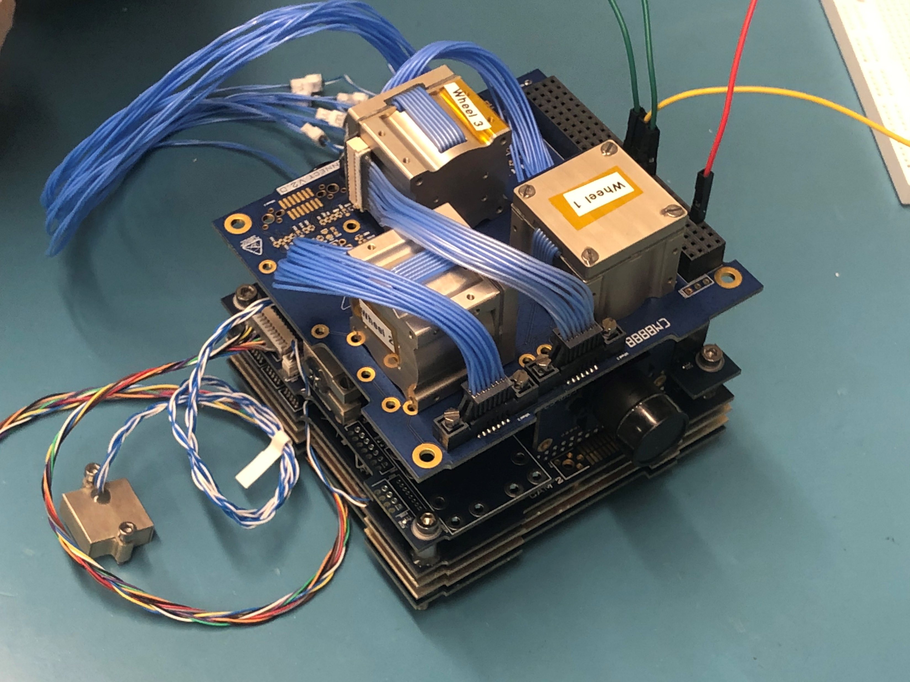

Mission Purpose
ADCS- to satisfy the pointing requirements of the EagleSat II mission for:
data collection
power generation
ground communication
EagleSat II- ADCS system

Slide 3
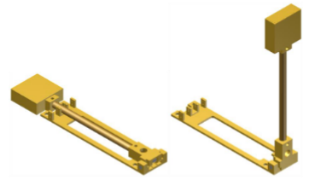
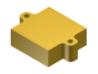
Attitude Determination
Sun and Nadir Cameras-
utilize image processing to recognize the sun and the Earth’s horizon respectively.
Coarse Sun Sensors-
10 positioned across the external faces of the CubeSat.
Each can detect the amount of sunlight they are receiving.
Magnetometer-
A sensor that can determine the direction and strength of a magnetic field.
CubeSpace- magnetometer
CubeSpace- redundant magnetometer

Slide 4
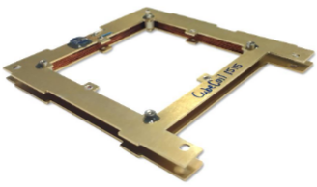
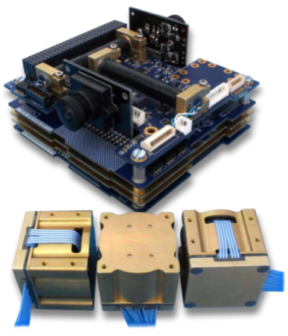
Attitude Control
CubeSpace- CubeTorquer Magnetorquer coil
Magnetorquers-
Apply a torque on the satellite due to their interaction with the magnetic field of the Earth
Reaction Wheels-
The CubeADCS utilizes reaction wheels to control the satellite’s spin rates about the x, y, and z axes.
CubeSpace- CubeSense, CubeComputer, and CubeWheels

Slide 5
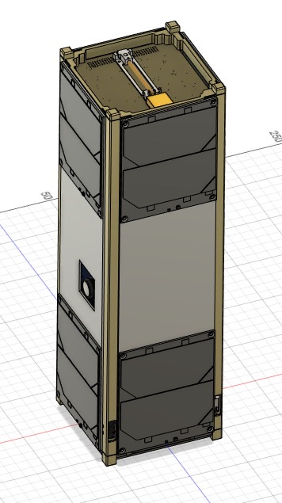
Operations
Detumble mode
Will be used soon after deployment from the ISS to reduce initial spin rates
Safe mode
Will be utilized to prevent the battery from falling below a nominal level of charge or another problem is detected.
Power Generation Mode
Will orient the satellite so its solar panels face the sun for optimal power generation.
Ground Pointing Mode
Prioritizes pointing the satellite’s antenna directly at the ground station for the duration of its flight overt the campus.
EagleSat II- external model
Lillian Sudkamp

Slide 6
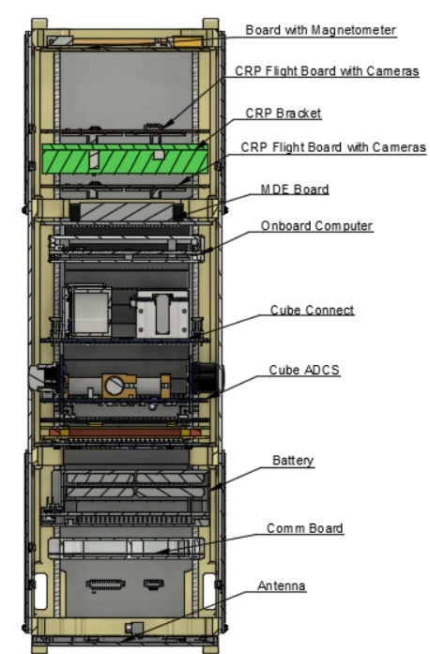
Next Steps
Next steps for EagleSat II- ADCS:
Develop command bank for use in testing and flight using the I²C command protocol
Integrate ADCS with other EagleSat II subsystems-
Onboard Computer
Electrical Power System
EagleSat II- external model
Lillian Sudkamp

